Slide 1

2BeConnected
By : Kaushik Patil (001056490)

Slide 2

Objective

Slide 3


The aim of my final project is to make a contact application website using Spring Web MVC Framework with Create, Read, Update and Delete (CRUD) Functionalities.

Slide 4
Technologies Used
Java EE – For JSP and Servlet
Framework – Spring Web MVC & Hibernate for Mapping
Database and Management – MySQL and MySQL Workbench
Integrated Development Environment (IDE) - NetBeans
Server – Apache Tomcat
UI Tech – HTML, CSS
JavaScript library – AJAX throw jQuery
Build Tool - Apache Maven

Slide 5

Project Requirements and Characteristics
Multiuser
Two Roles : User and Admin
Systematic User Registration
Login and Logout for User Account
Add Contacts Feature
Update Contacts Feature
Delete Contact Feature
Bulk Delete Feature
Search Contact Feature with keyword
Contact List with all contact details
Admin can see all the registered users
Admin has functionality to activate or block the user account
PDF generator in admin account

Slide 6
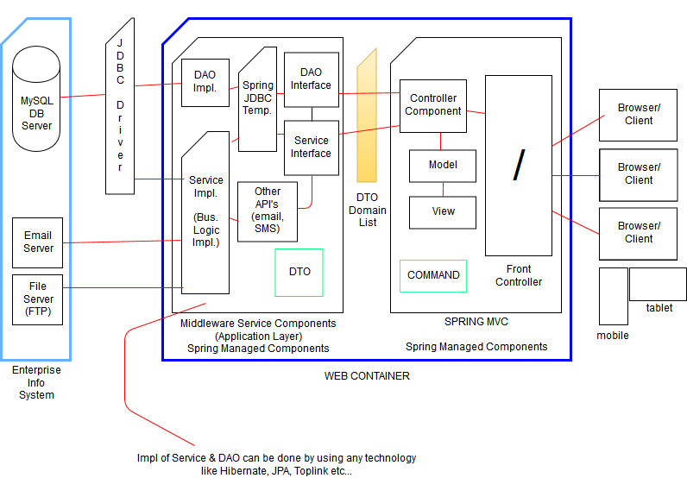

Project Architecture

Slide 7

Database Entities
Contact
Contact ID
Name
Phone
Email ID
Address
Remark
User
User ID
Name
Phone
Email ID
Address
Login Name
Password
Role
Login Status

Slide 8
SQL Commands
CREATE TABLE `contact` (
`contactId` int(11) NOT NULL AUTO_INCREMENT,
`userId` int(11) DEFAULT NULL,
`name` varchar(50) DEFAULT NULL,
`phone` varchar(50) DEFAULT NULL,
`email` varchar(50) DEFAULT NULL,
`address` varchar(150) DEFAULT NULL,
`remark` varchar(150) DEFAULT NULL,
PRIMARY KEY (`contactId`),
KEY `user_fk_idx` (`userId`),
CONSTRAINT `user_fk` FOREIGN KEY (`userId`) REFERENCES `user` (`userId`) ON DELETE CASCADE ON UPDATE NO ACTION
);
CREATE TABLE `user` (
`userId` int(11) NOT NULL AUTO_INCREMENT,
`name` varchar(50) DEFAULT NULL,
`phone` varchar(50) DEFAULT NULL,
`email` varchar(50) DEFAULT NULL,
`address` varchar(150) DEFAULT NULL,
`loginName` varchar(45) NOT NULL,
`password` varchar(50) DEFAULT NULL,
`role` int(1) NOT NULL DEFAULT '2',
`loginStatus` int(1) NOT NULL DEFAULT '1',
PRIMARY KEY (`userId`),
UNIQUE KEY `loginName_UNIQUE` (`loginName`)
);

Slide 9

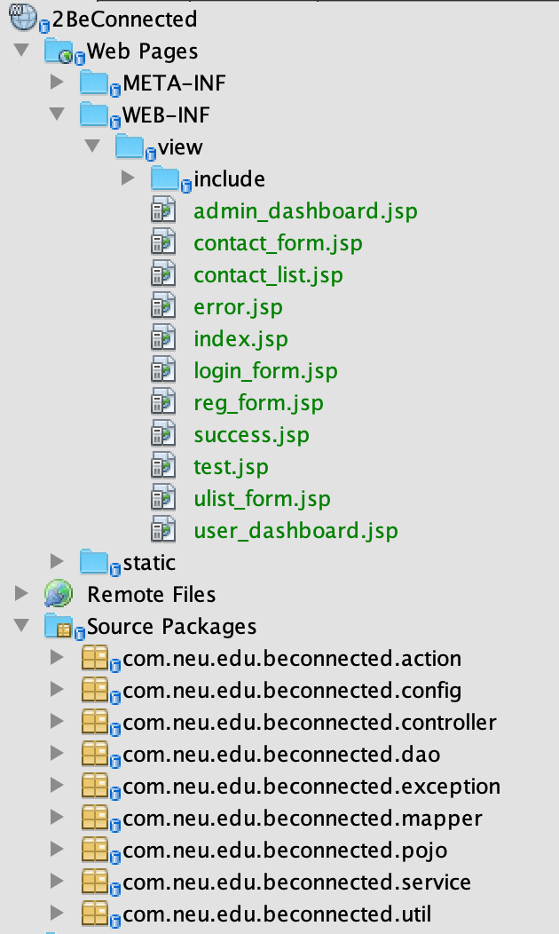
Project Structure

Slide 10

Project UI Design

Slide 11


Slide 12


Slide 13
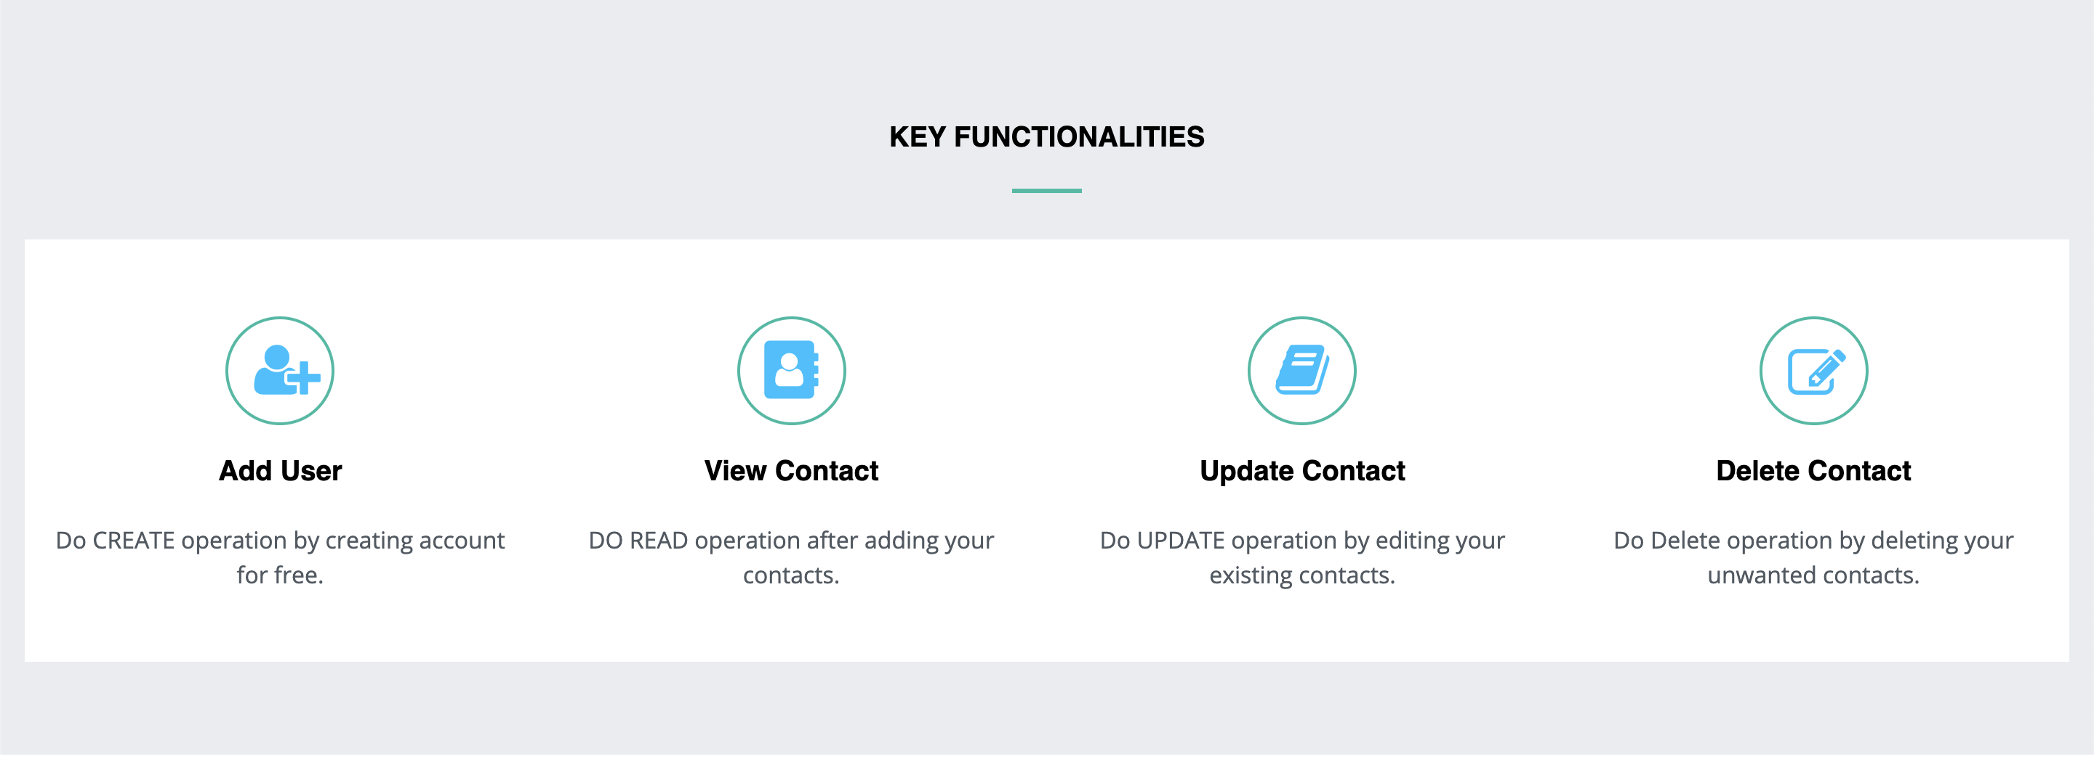

Slide 14
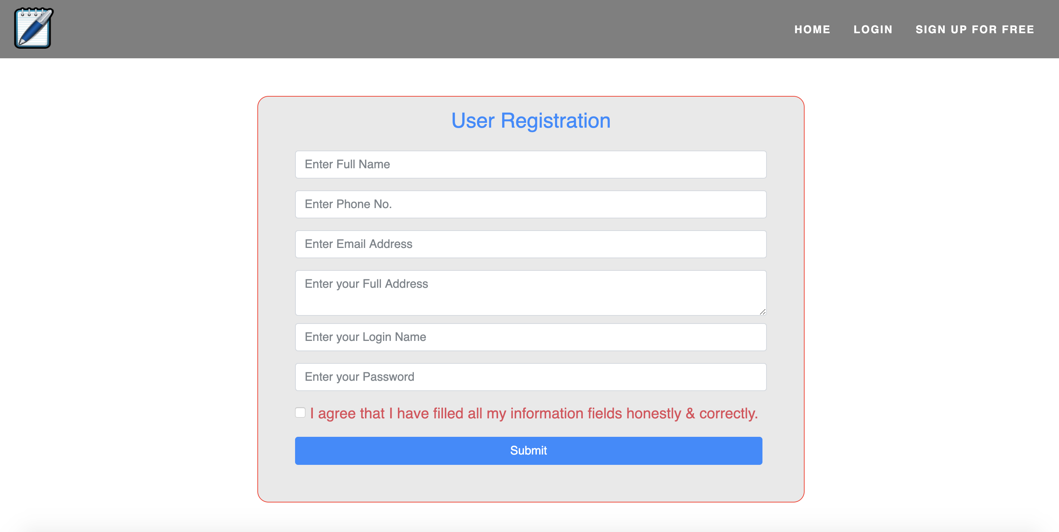

Slide 15
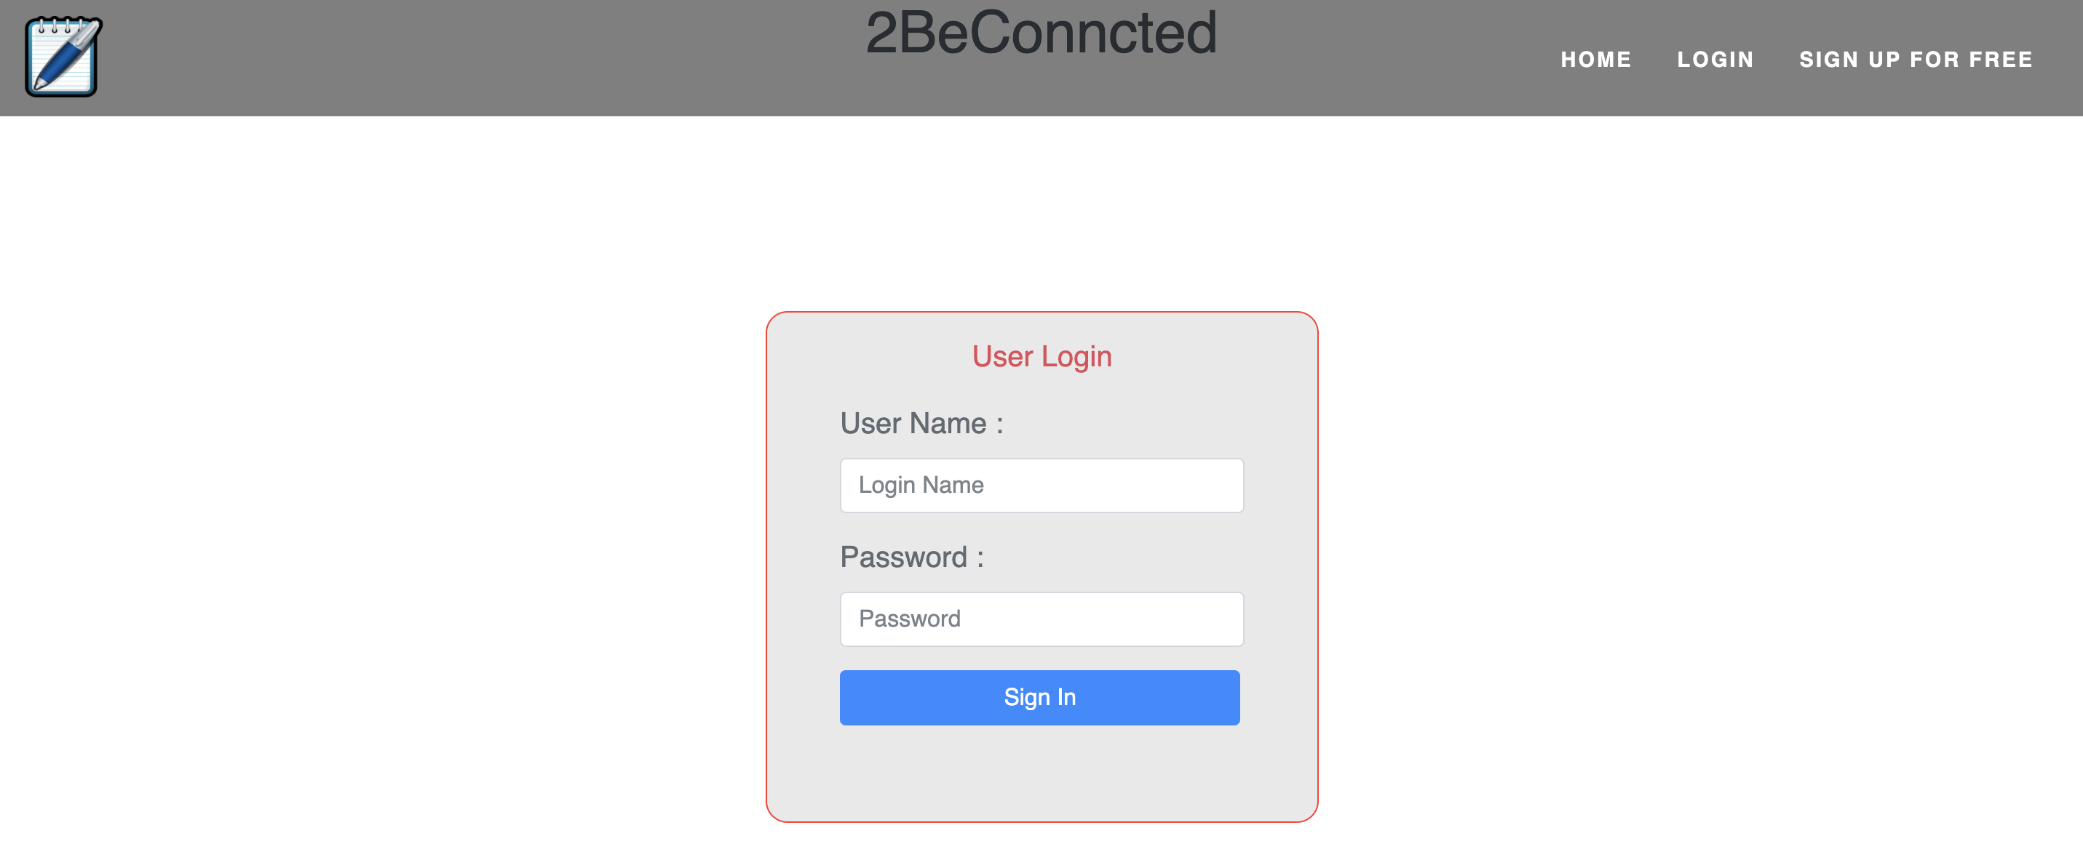

Slide 16
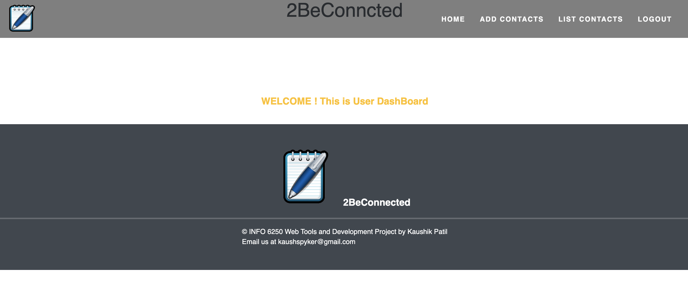

Slide 17
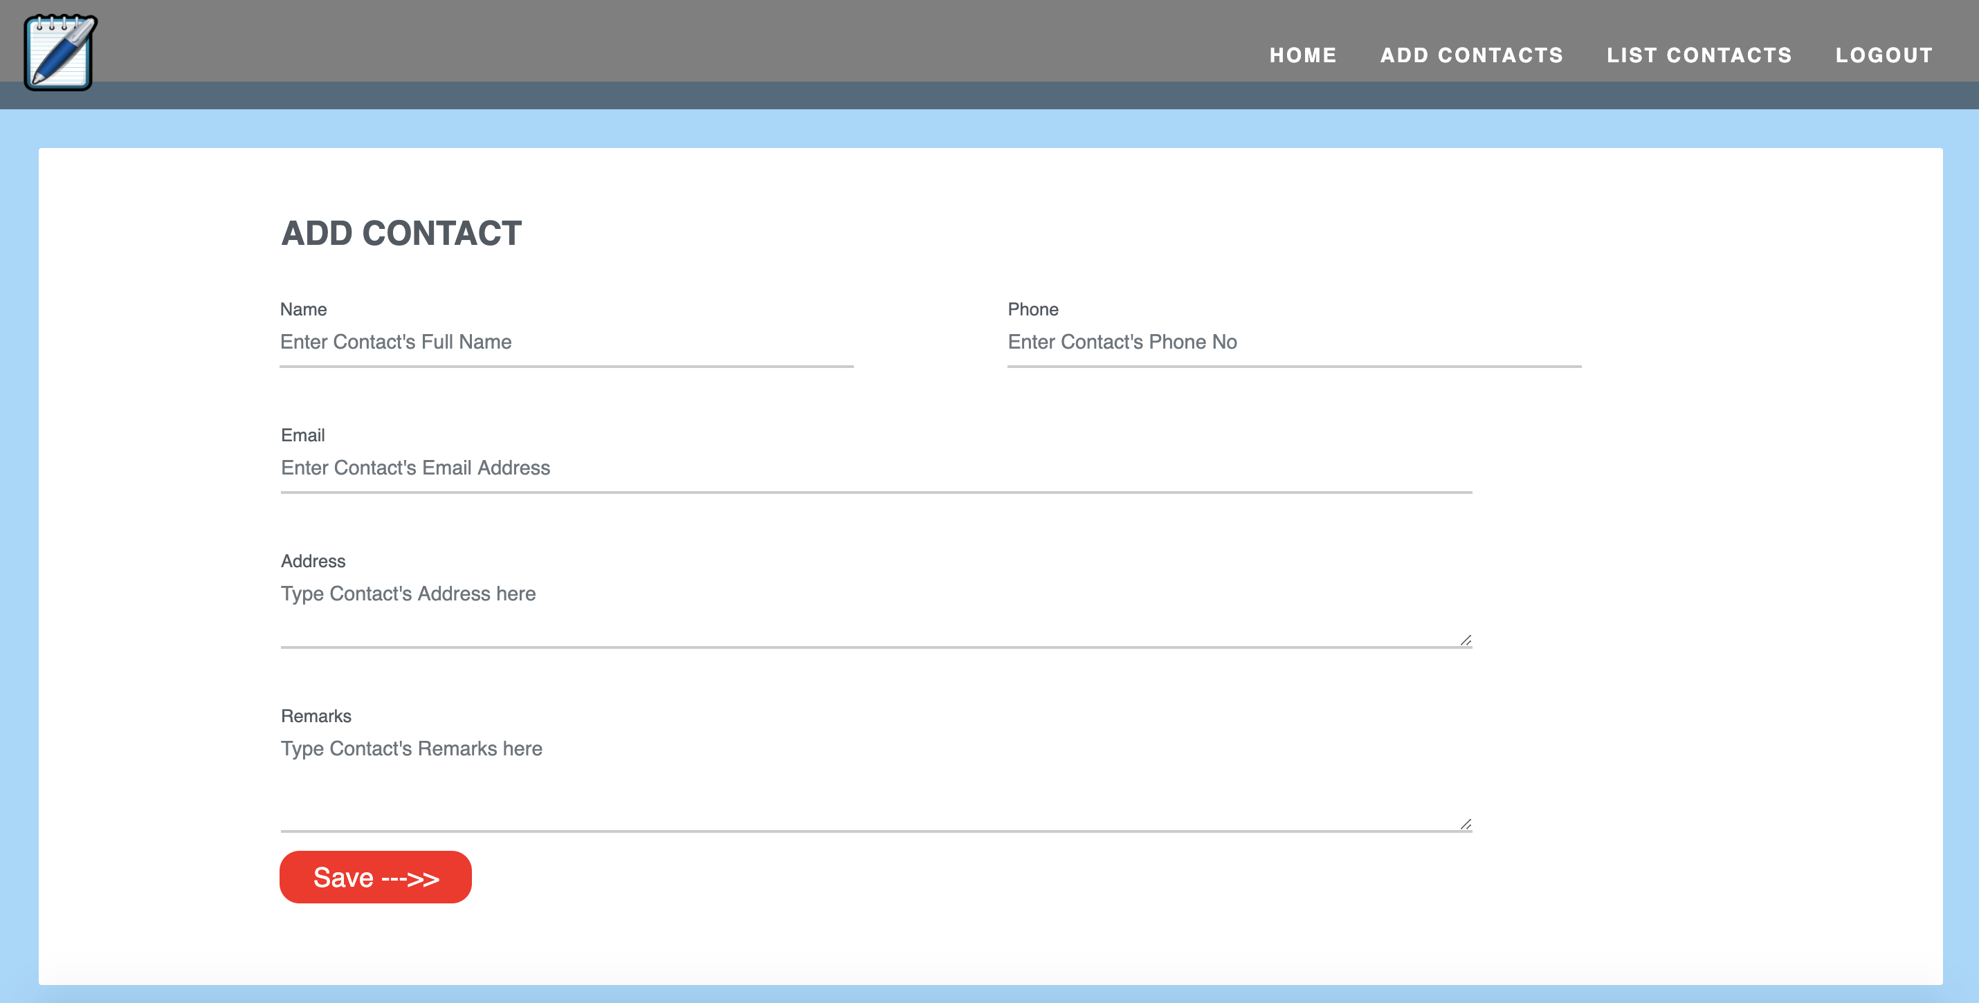

Slide 18
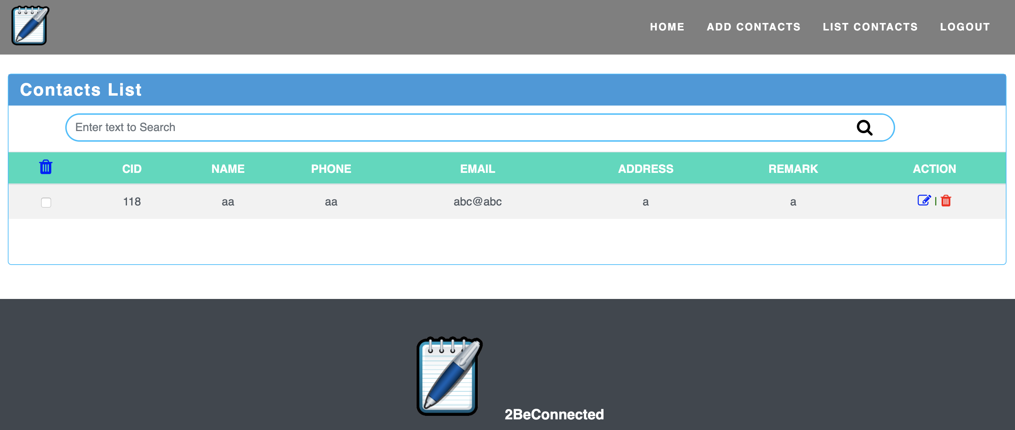

Slide 19


Slide 20
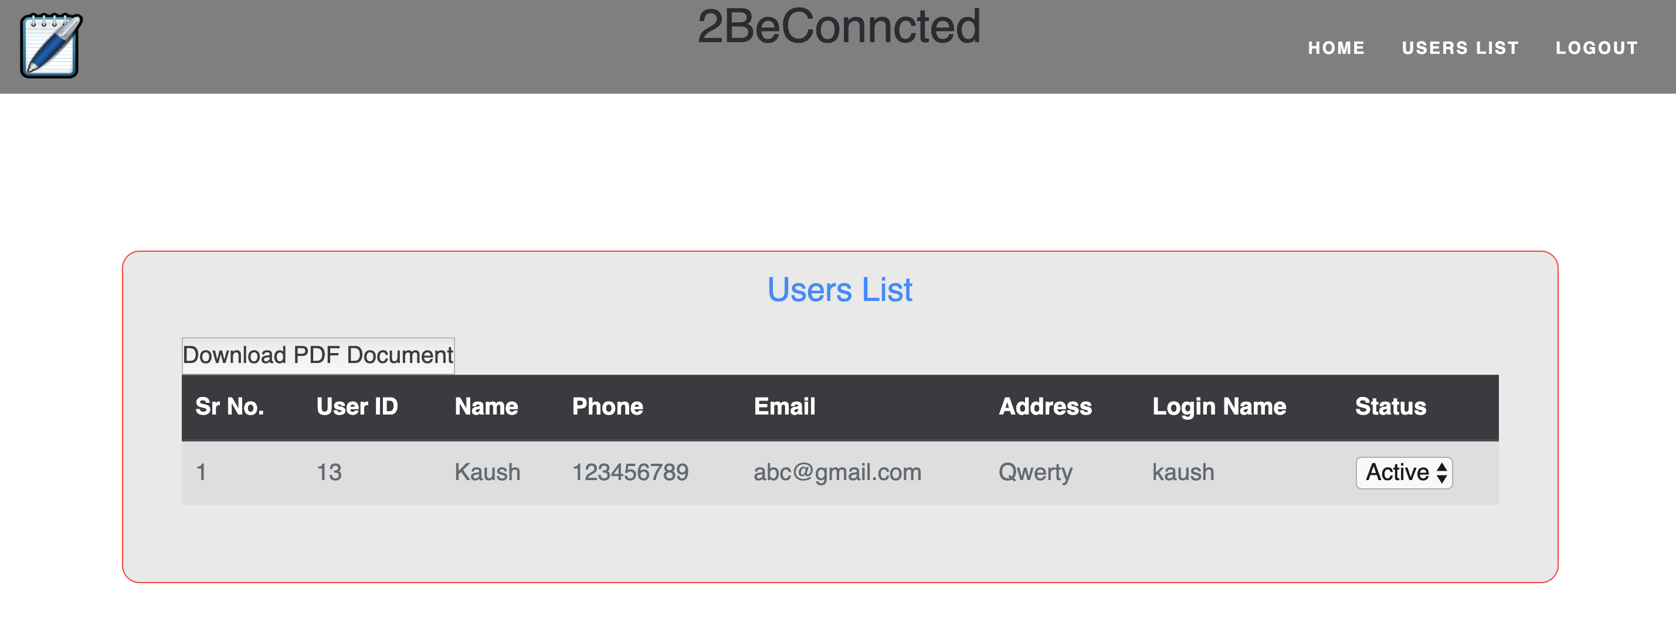

Slide 21


Slide 22

Thank you

